Slide 1
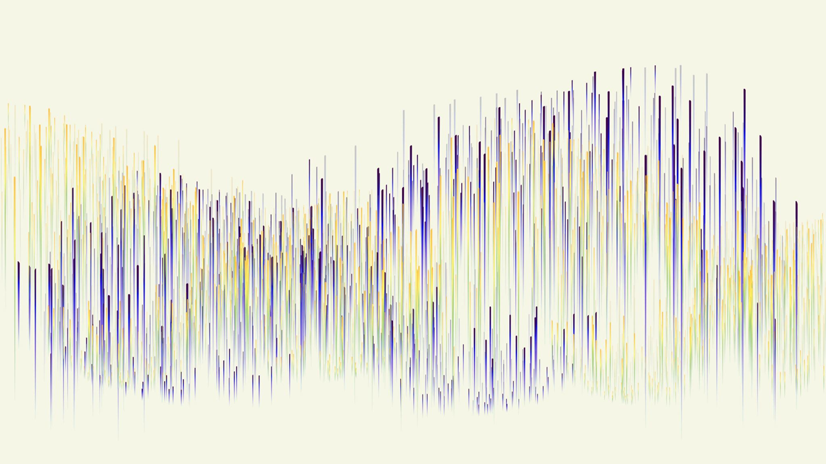

Trigonometric Interpolation
Sebastian (Pockenauer |Kranzinger),
Martin Dallinger

Slide 2
Overview
Definitions
Motivation
Function Approximation
(evenly Spaced)
General Approximation
(Lagrange)
Code Demo

Slide 3
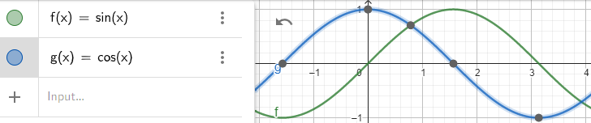
Trigonometric Functions
“…a set of functions which relate angles to the sides of a right triangle”
-> Elementary: sin(x), cos(x)
-> Representable as complex numbers (later)
Definitions – Motivation – Function Approximation – Lagrange Approximation – Code Demo

Slide 4
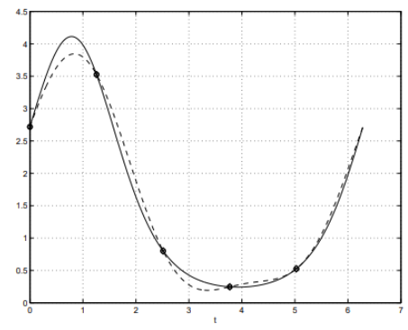
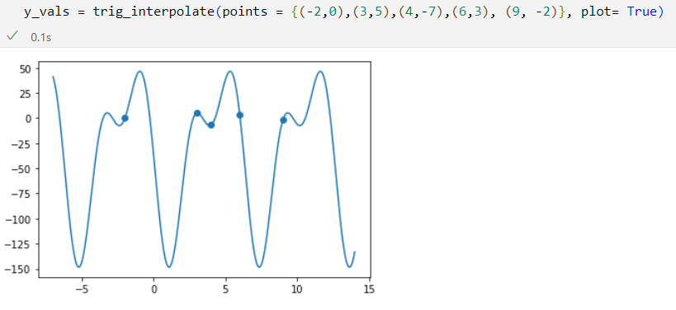
Interpretations of „Interpolation“
„Interpolation“: Construct/Find new points based on known ones
Evenly-Spaced approximation of a different function:
Only based on a set of points:
Definitions – Motivation – Function Approximation – Lagrange Approximation – Code Demo

Slide 5
Motivation
Engineering design and analysis:
Modeling periodic signals in electrical, mechanical and acoustical systems
Analysis of vibrations, resonances and stability in structures and machines
Image and Signal Processing:
Compression of digital audio and video signals
Removing noise from images
Geographical Information Systems:
Interpolation of elevation data for digital terrain models
Modelling ocean tides and wave patterns
Medical imaging and analysis:
Reconstruction of 2D and 3D images from tomographic scans
Analysis of ECG and EEG signals
Definitions – Motivation – Function Approximation – Lagrange Approximation – Code Demo

Slide 6
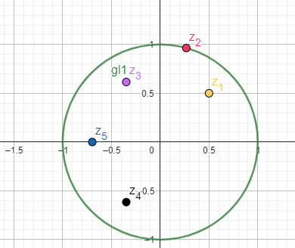
Modeling Trig. Functions in ℂ
GeoGebra Demo-Time:
https://www.geogebra.org/calculator/c4hgvp5f
Definitions – Motivation – Function Approximation – Lagrange Approximation – Code Demo

Slide 7

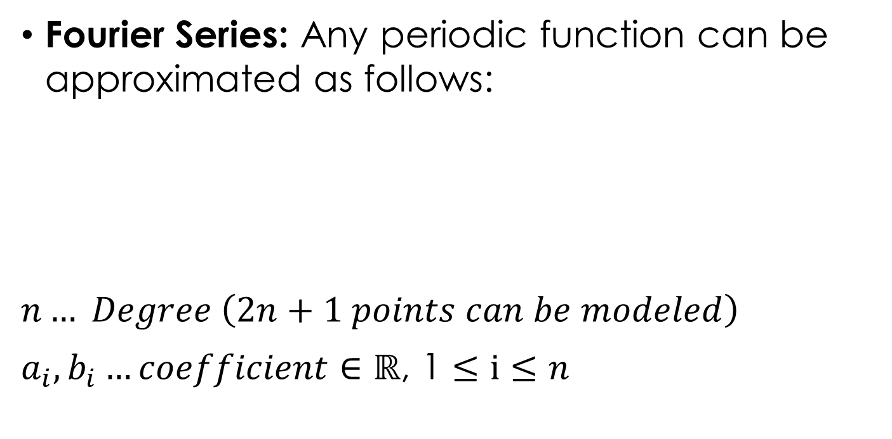
Evenly-Spaced Function Approx.
Fourier Series: Any periodic function can be approximated as follows:
$n… Degree \left(2n+1 points can be modeled\right)$
$a_{i}, b_{i}…coefficient∈\text{ℝ}\text{, 1}≤i≤n$
Definitions – Motivation – Function Approximation – Lagrange Approximation – Code Demo

Slide 8
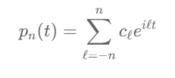
Interpolation Task
Simplify Formula with complex numbers:
Definitions – Motivation – Function Approximation – Lagrange Approximation – Code Demo

Slide 9


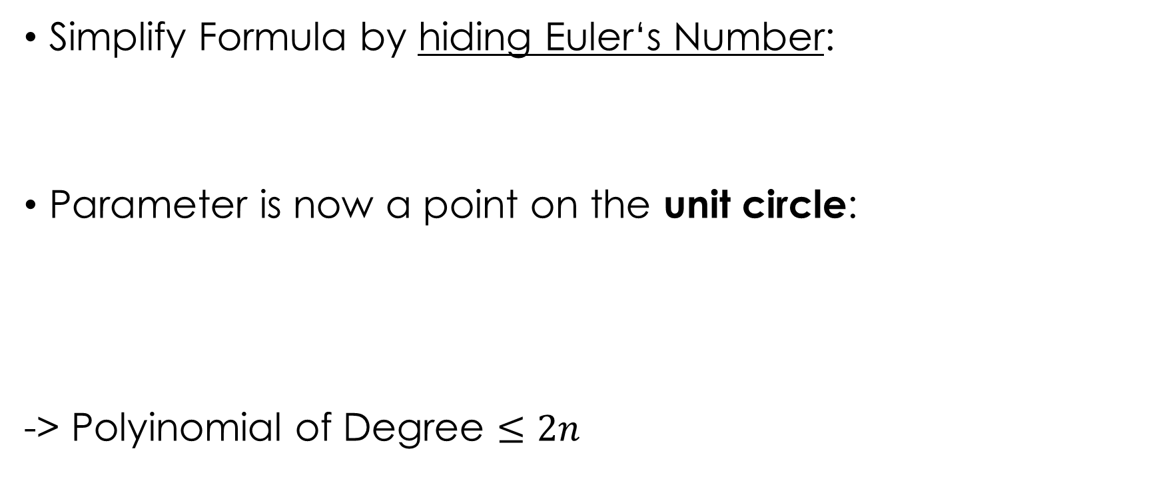
Interpolation Task
Simplify Formula by hiding Euler‘s Number:
Parameter is now a point on the unit circle:
-> Polyinomial of Degree $≤2n$
Definitions – Motivation – Function Approximation – Lagrange Approximation – Code Demo

Slide 10


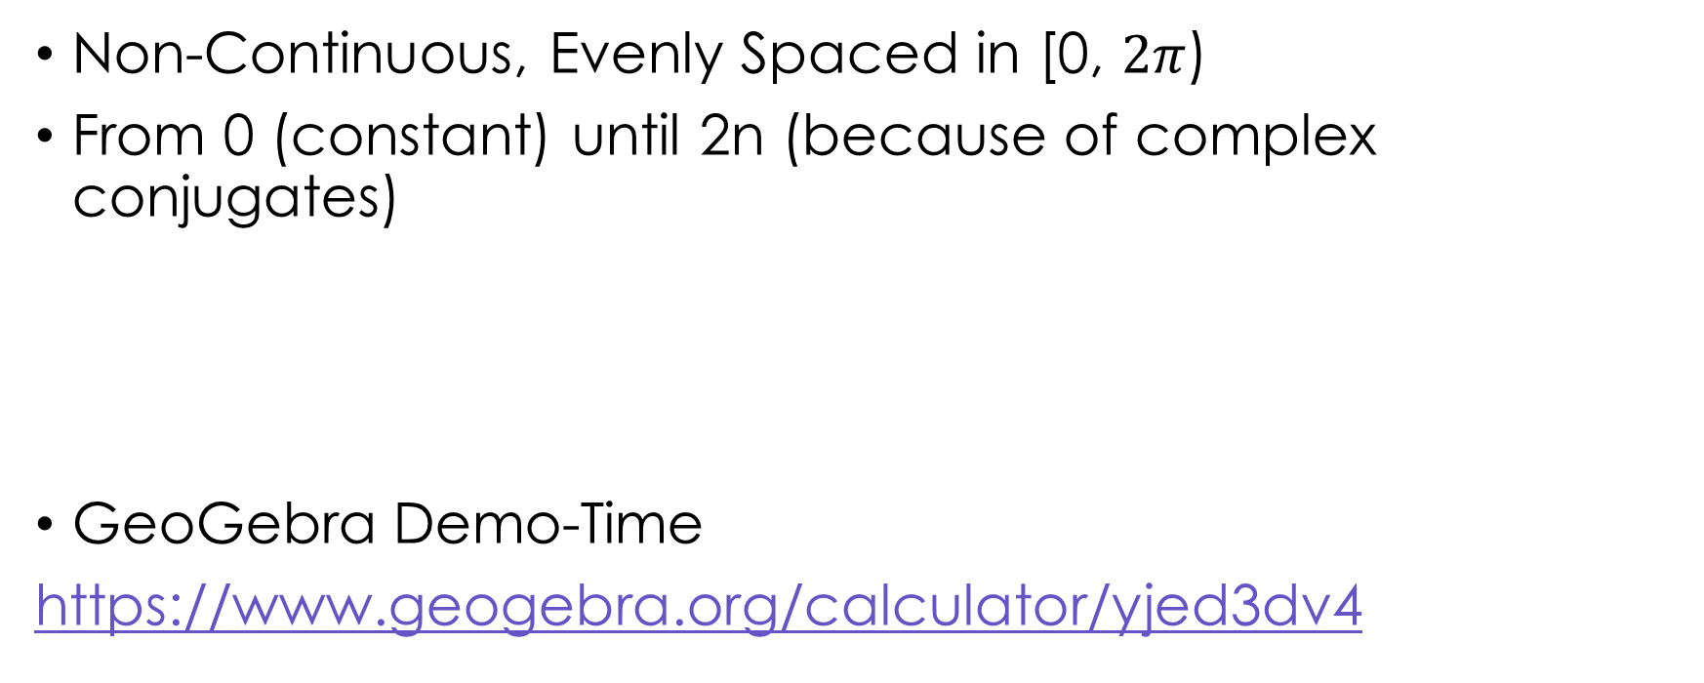
Define matching points
Non-Continuous, Evenly Spaced in [0, $2π$)
From 0 (constant) until 2n (because of complex conjugates)
GeoGebra Demo-Time
https://www.geogebra.org/calculator/yjed3dv4
Definitions – Motivation – Function Approximation – Lagrange Approximation – Code Demo

Slide 11




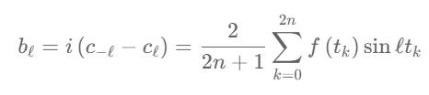



Solution to the problem
For complex coefficient k:
Match given function $f$ at the supplied timings $t_{l}$
Compute real/imaginary parts directly:
Definitions – Motivation – Function Approximation – Lagrange Approximation – Code Demo

Slide 12
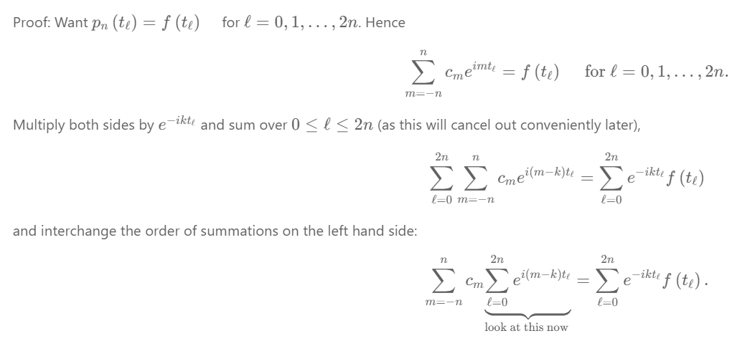

Proof
Definitions – Motivation – Function Approximation – Lagrange Approximation – Code Demo

Slide 13
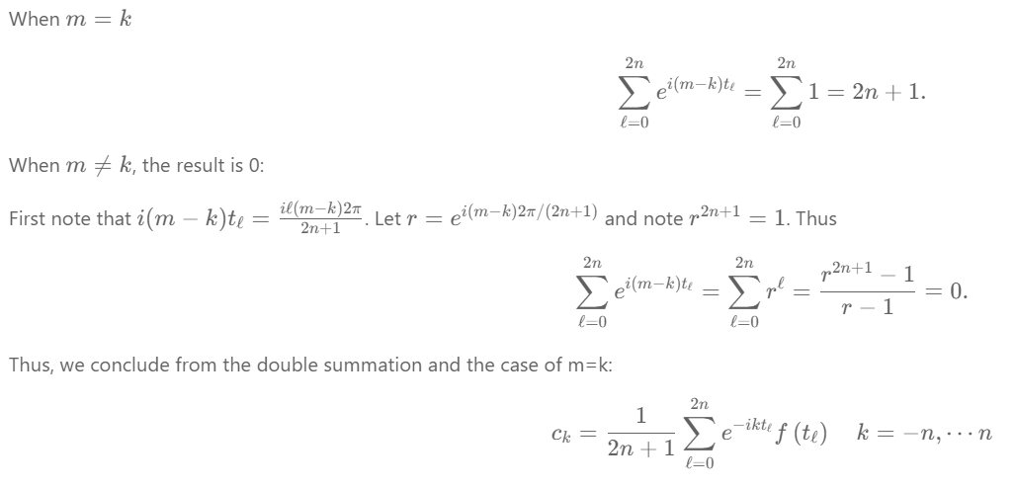
Proof cont.
Definitions – Motivation – Function Approximation – Lagrange Approximation – Code Demo

Slide 14




Example from Paper
Find the trigonometric polynomial interpolation of degree 2 to $f\left(t\right)=e^{\sin{t+\cos{t}}} on [0,2π)$
Definitions – Motivation – Function Approximation – Lagrange Approximation – Code Demo

Slide 15
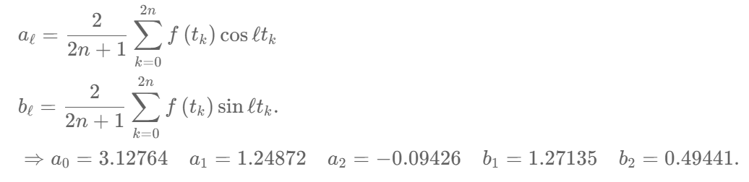
Example from Paper
Find the trigonometric polynomial interpolation of degree 2 to $f\left(t\right)=e^{\sin{t+\cos{t}}} on [0,2π)$
Definitions – Motivation – Function Approximation – Lagrange Approximation – Code Demo

Slide 16
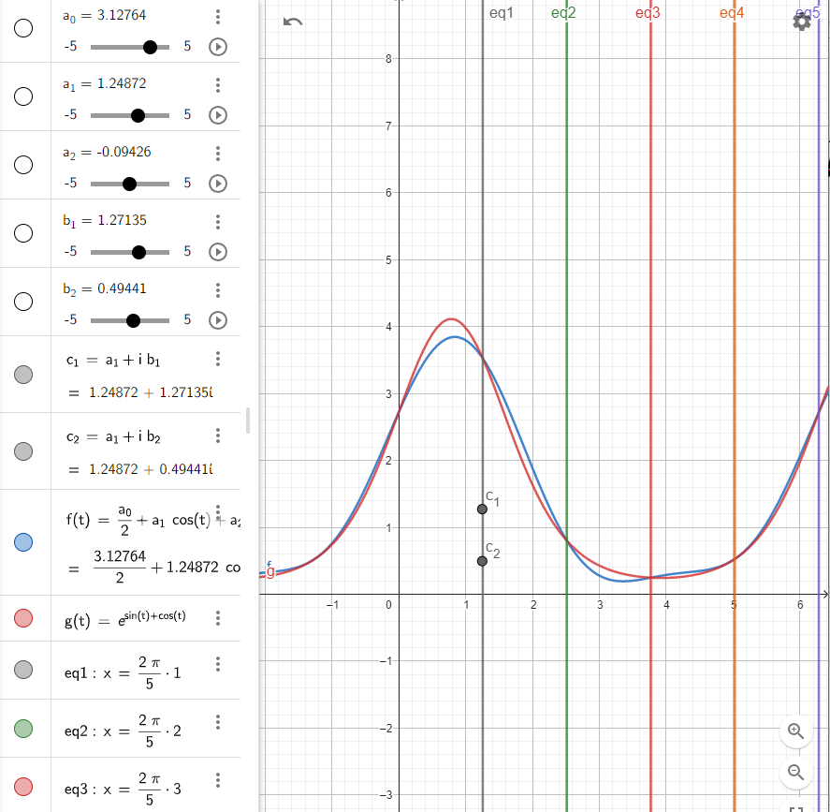

Visualization of the Example
https://www.geogebra.org/calculator/c8pdmtqv
Definitions – Motivation – Function Approximation – Lagrange Approximation – Code Demo

Slide 17
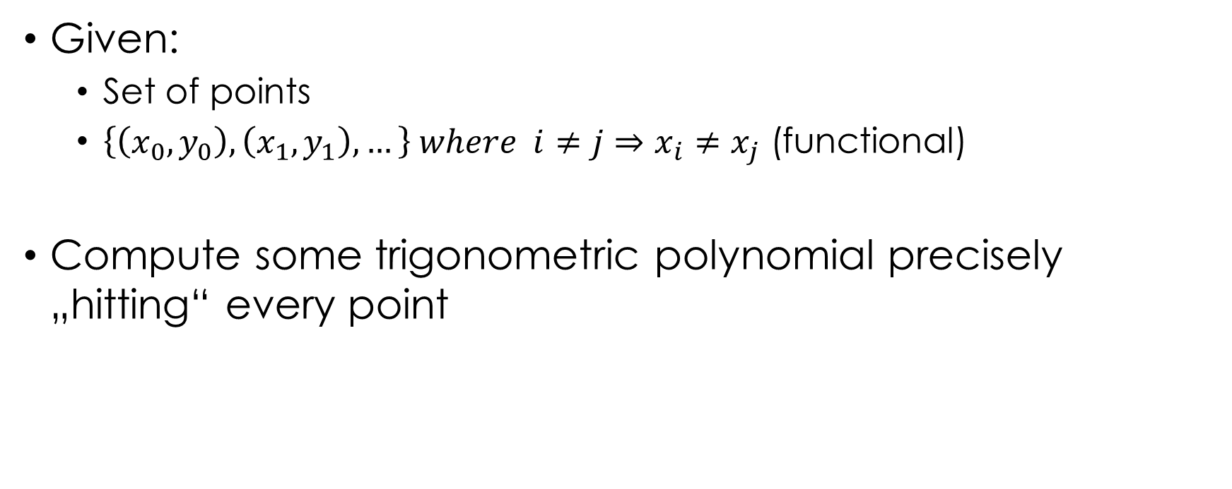
General Case – Task Description
Given:
Set of points
$\left\{\left(x_{0}, y_{0}\right),\left(x_{1}, y_{1}\right), …\right\} where i≠j⇒x_{i}≠x_{j}$ (functional)
Compute some trigonometric polynomial precisely „hitting“ every point
Definitions – Motivation – Function Approximation – Lagrange Approximation – Code Demo

Slide 18
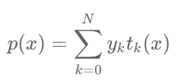
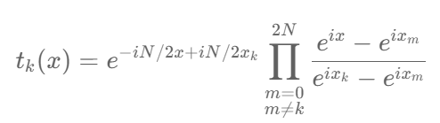
Lagrange Interpolation
Polynomial formulation (Complex Plane with N points):
Basis function (1 for point to hit, 0 for every other one):
Definitions – Motivation – Function Approximation – Lagrange Approximation – Code Demo

Slide 19
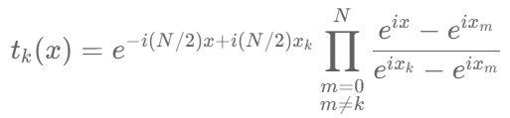

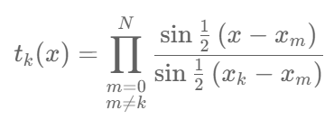
Simplifying the Basis function
This ignores that N can be even (only relevant for a proof, more precise formulation linked in Notebook):
By using this identity:
We rewrite:
Definitions – Motivation – Function Approximation – Lagrange Approximation – Code Demo

Slide 20
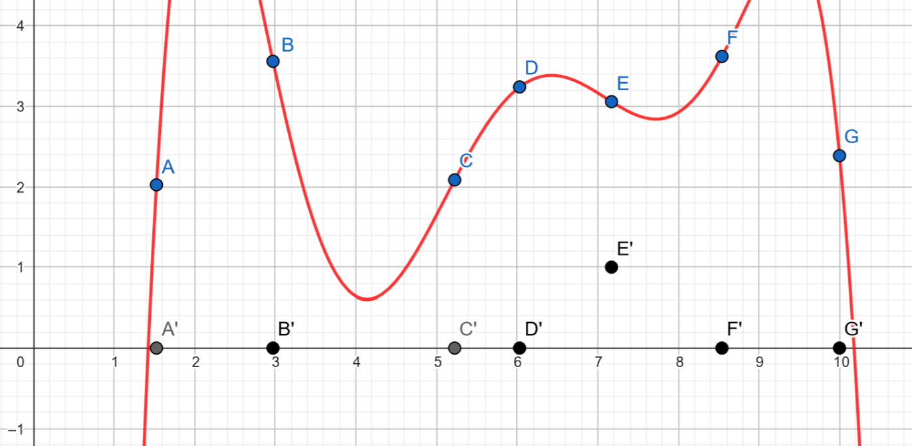
Visualizing Non-Trigonometric Func.
GeoGebra Demo-Time:
Definitions – Motivation – Function Approximation – Lagrange Approximation – Code Demo

Slide 21
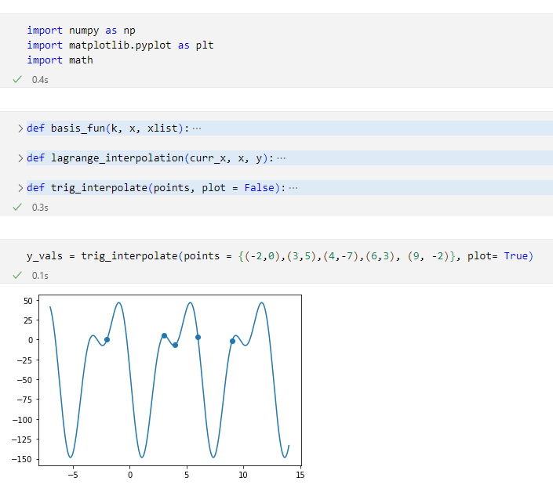
Python Implementation
Interactive Demo-Time:
Definitions – Motivation – Function Approximation – Lagrange Approximation – Code Demo

Slide 22
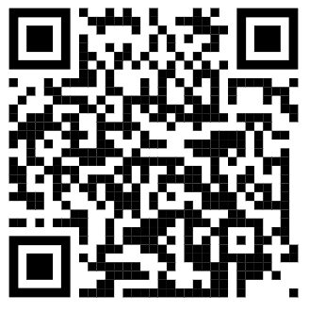
Questions?
Sources, Code and Presentation: https://github.com/S0urC10ud/Trigonometric-Interpolation/

